Slide 2
Objectives
Understand the need for secondary storage
Describe the operation of the following types of storage and give examples of each:
Magnetic storage
Optical storage
Solid-state storage

Slide 3
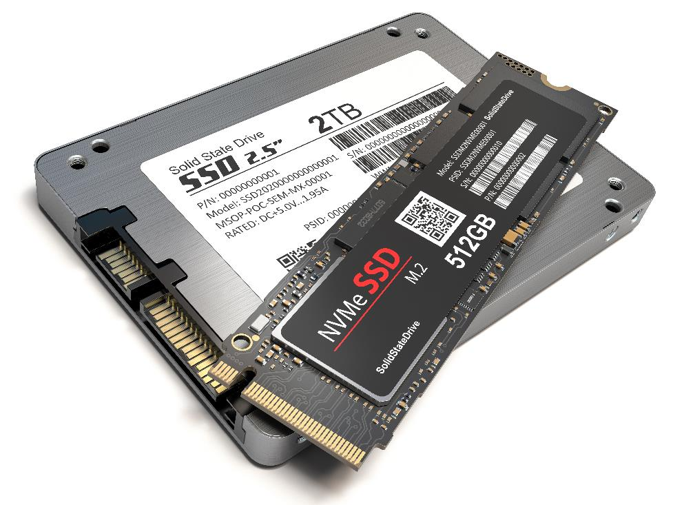

Starter
RAM is a type of primary storage
It has a fast data rate but is volatile (the data is lost if there is no power)
What storage devices are used that are non-volatile?

Slide 4

Secondary storage
Secondary storage is not directly accessed by the CPU and is needed for permanent storage of data
It is non-volatile, meaning it will keep data even if there is no power
Secondary storage devices may be internal or external to the computer
What is secondary storage used for?

Slide 5
Uses of secondary storage
It has many different uses – for example:
Programs and data are stored on hard drive
Blu-rays may be used to distribute films
Memory sticks may be used to transport data from one place to another
Magnetic tape or external hard drives may be used for backup
SD cards can be used for additional storage on cameras and smartphones – this is used for music, video and photos

Slide 6
Storage types
Primary storage
RAM and ROM
Secondary storage
Hard Disk Drive (HDD)
Solid State Drive (SSD)
Offline secondary storage
Compact Disc (CD), Digital Versatile Disc (DVD) or BluRay
Flash memory, SD cards
Removable HDD or SSD
Magnetic tape

Slide 7
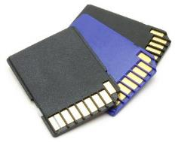
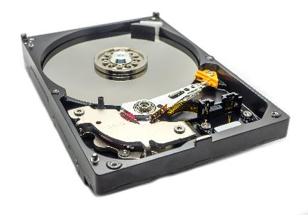
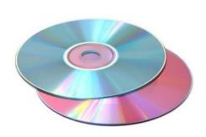
Storage methods
Magnetic: Mechanical parts move over the disks surface to read and write data magnetically, or a drive head reads a magnetic tape
Optical: Lasers read and write data using light
Solid State: Data is recorded onto solid memory chips without any moving parts

Slide 8
Worksheet 5
Complete Task 1 on Worksheet 5

Slide 9
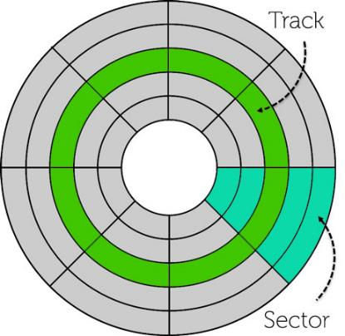
Magnetic disks
Basic features:
Disk contains concentric circles called tracks
Each track is divided into sectors
Disk heads mounted on mechanical arms read and write the data
A disk with a solid platter is a ‘hard’ disk
Soft plastic disks are known as ‘floppy’ disks

Slide 10
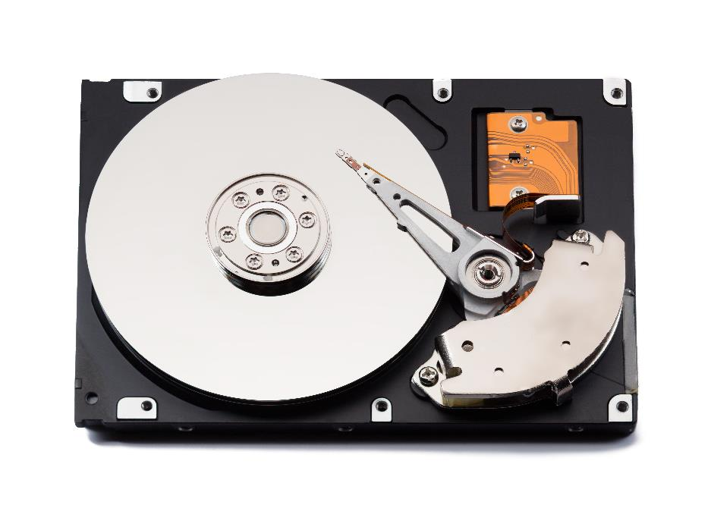
Hard disks
Parts of a hard disk
Drive read/write head reads data on the drive using electromagnets
Magnetic platter contains data –
Hard disks may contain more than one platter
Actuator moves the read/write arm
Drive spindle rotates

Slide 11
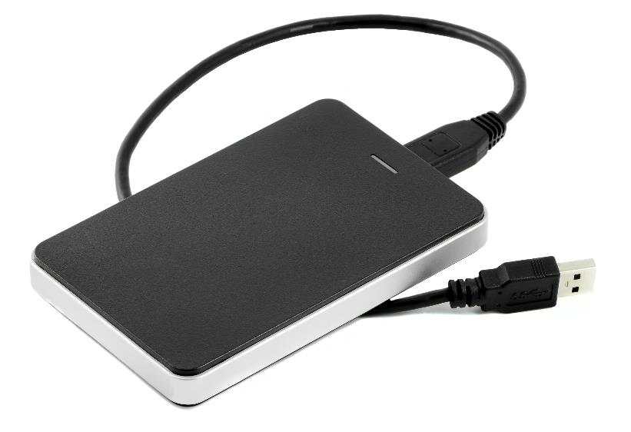

Magnetic storage: hard disks
Fixed magnetic hard disks are still used in many PCs and laptops
They have a very large storage capacity, up to 6TB or more
They are a very cheap form of storage compared to solid state drives
Portable hard disks can be connected to a computer via a USB port
They are used for backing up or transporting data

Slide 12
Magnetic storage
Advantages:
Cheap, large storage capacities, relatively fast write speed
Disadvantages:
Lots of mechanical parts, durability an issue, sealed unit due to disk head and platter precision and not very portable
Uses:
Personal computers, storage of large quantities of data
Capacity:
500GB - 12TB or greater

Slide 13
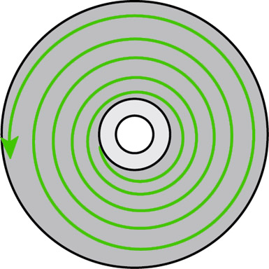
Optical storage
Basic features:
Data is stored as pits and lands burnt or pressed into a spiral track circulating outwards from the centre
A laser beam passes over the pits and lands the level of reflection is measured
From this signal, 0s and 1s can be derived

Slide 14
Optical storage
Advantages:
Cheap, very easily portable, takes up little space physically
Disadvantages:
Less storage capacity compared to other types
Easily damaged / scratched, requires a CD reader
Slow write speeds
Uses:
Songs, videos and other multi-media storage, backup and archiving of data
Capacity:
CD-ROM – up to 720 MB
DVD – up to 8.4 GB (dual layered disk)
Blu-Ray – up to 50 GB (dual layered disk)

Slide 15
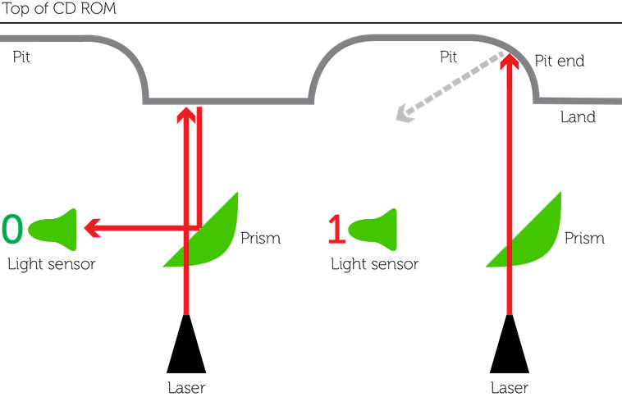
How CDs work

Slide 16
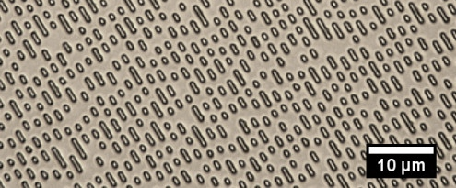
CDs, DVDs and BluRay
Why are the capacities of these discs different given they are all the same physical size?
Microscopic view of the surface of a CD ROM

Slide 17
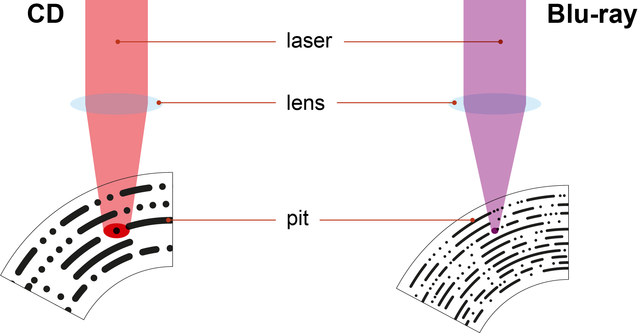
Pit size and laser wavelength
A CD has bigger pits and lands than Blu-ray as red light has a larger wavelength
The smaller Blu-ray pits and lands allow it to store more data

Slide 18
Worksheet 5
Complete Task 2 and Task 3 on Worksheet 5

Slide 19
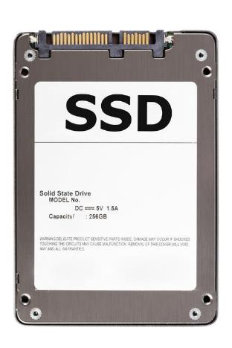
Solid State Drives (SSD)
Basic features:
Solid-state disks use non-volatile flash memory to store information
Very fast read/write speeds as it doesn’t need to wait for a disk to spin to the correct location and an arm to move
No mechanical or moving parts meaning these disks are very durable

Slide 20
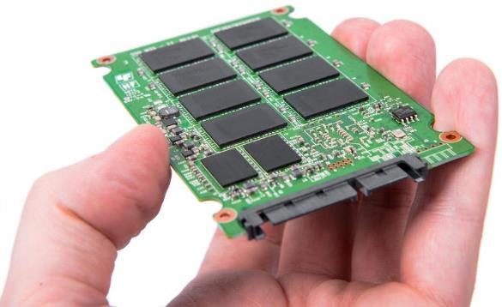
Advantages /disadvantages of SSDs
Advantages:
Highly durable, no moving parts, very fast read/write speeds, no noisy fan or drive arm, faster start up times
Disadvantages:
More expensive than magnetic hard disks, similar storage capacity as magnetic disks
Uses:
Higher end computers
Laptops
Smartphones and tablets
Capacity:
100GB – 16TB

Slide 21

Flash memory
Low cost, portable, no moving parts, durable
This makes them ideal for a range of offline devices:
Cameras
Mobile phones
USB memory sticks

Slide 22
How flash memory stores data
A floating gate may store or not store electrons
If no electrons are present in the floating gate the current will flow, representing a 1
If electrons are stored in the floating gate, the current doesn’t flow, representing a 0
1
0
Control Gate
Control Gate
Control Gate
Isolation Layer
Isolation Layer
Isolation Layer
Electrons
Floating Gate
Isolation Layer
Isolation Layer
Isolation Layer
SOURCE
DRAIN
SOURCE
DRAIN
SOURCE
DRAIN

Slide 23
The isolation layer
The isolation layers are semiconductors known as transistors
In order to write to the flash memory cell, the electrons need to pass through the isolation layer
The electrons only move through this layer when writing
Normally, they remain trapped in the floating gate
Control Gate
Isolation Layer
Electrons are trapped
Isolation Layer
SOURCE
DRAIN

Slide 24
How flash memory writes data
The control gate is used to move electrons into or out of the floating gate
A negative voltage forces electrons out of the floating gate
A positive voltage forces electrons into the floating gate
Control Gate
-ve voltage
+ve voltage
Isolation Layer
Isolation Layer
Isolation Layer
Electrons
Floating Gate
Isolation Layer
Isolation Layer
Isolation Layer
SOURCE
DRAIN
SOURCE
DRAIN
SOURCE
DRAIN

Slide 25
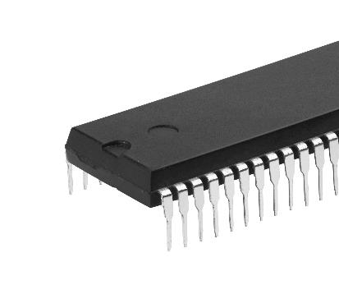
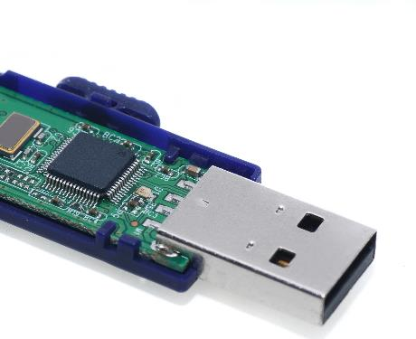
Solid-state (flash memory)
Two types of flash memory are available
NOR flash memory is used for programs
Reading from NOR flash is random access like RAM
It is used to store code such as the BIOS and possibly an operating system and code is executed directly by the CPU
NAND memory is used for data storage
NAND memory works like other secondary storage
Data is first copied to RAM before it is accessed by the CPU

Slide 26
Worksheet 5
Complete Task 4 on Worksheet 5

Slide 27

Plenary
In pairs, give answers to the following:
Name 5 components inside a hard disk drive
Name 4 components on a DVD or inside a DVD drive
Name 3 technologies that storage devices use
Name 2 parts of a memory cell in solid state storage
Name 1 word that means 1024 Gibibytes

Slide 28
Plenary
Name 5 components inside a hard disk drive Track, sector, platter, spindle/motor, read/write head, actuator
Name 4 components on a DVD or inside a DVD drive Pit, land, laser, light sensor, prism
Name 3 technologies that storage devices use Magnetic, optical, solid-state
Name 2 parts of a memory cell in solid state storage Control gate, floating gate, isolation layer
Name 1 word that means 1024 Gibibytes - Mebibyte

